Slide 1
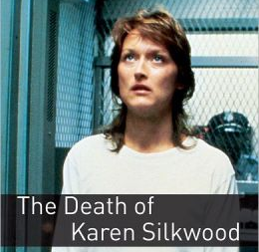
Book: The Death of Karen Silkwood
Escola EB 2,3 Dr. Ruy d’Andrade
Maria joana faria, nº 16, 9º h
teacher maria josé machado - english

Slide 2
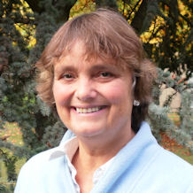
About the author: Joyce Hannam
Joyce Hannam was born in 1972 in Cambridge, and she’s an experienced teacher and writer of stories for English learners.
Having graduated from Oxford University with a degree in English Literature, she trained as a secondary school teacher and worked in a London school for a year. Then she decided to move from literature to language education.
Now she lives in York, in the north of England, with her husband.

Slide 3
The story
This is a true story about the death of Karen Silkwood, and it’s a mystery.
Nobody really knows what happened. Was it an accident? We don’t know…

Slide 4
The accident
A woman called Karen Silkwood was found dead inside her car. She lived in Oklahoma, USA. Nobody really knows what happened. The police is sure that it was an accident, but three men, her boyfriend, a newspaper journalist from the New York Times, and a Union official from Washington, don’t think that way.
In the night of the accident, they were waiting for her. She was bringing an important piece of information in a brown envelope.

Slide 5
The nuclear factory
The story of Karen and her brown envelope began in 1972, when she took a new job at a nuclear factory. Before, she worked as secretary and she was tired of that function. The factory’s salary was better and the work was more interesting.
She knew the workers, the factory’s installation, the protection clothes and other things. Karen was very happy and everything was going well.

Slide 6
Karen and Drew, when they began a relationship
She made good friends like Susan and Drew. They were always together.

Slide 7
Karen, Susan and another woman
But in the summer of 1974, everything started to change. The scanner detected in Susan’s body radioactive dust and she was taken into the shower room. After it, Susan was a different person.
One day, Karen and Susan talked about the factory. Some people wanted to leave the work, but Karen decided to change things there. So she became an official on the factory’s Union Committee.

Slide 8
Karen stealing negatives from the photographic laboratory
The safety at the factory was getting worse each day. The scanner also detected in Karen’s body radioactive dust and she was taken into the shower room. The Commitee asked for help to the Union leaders in Washington and Karen went there.
Talking to the leaders, she explained what was happening in the factory, mainly about the photographic laboratory that was changing the negatives of the photographs of the fuel and uranium rods. But proofs were necessary and she would do anything to take them.

Slide 9
Karen was really scared
That was a danger to Karen’s life. And things got worse to her. Alone, all she had was a brown envelope with proofs.

Slide 10
Karen’s objects in protective plastic bags
One day, when Karen had everything ready inside the brown envelope, she went to the factory. She passed the scanner and it detected, again, radioactive dust. But it was very strange, because Karen was entering the factory and not leaving. That meant that all the places where she had passed were contaminated, including her own home. All the objects were taken from there and she didn’t have any place to spend the night. So she went to Drew’s house, and told him her whole plan.

Slide 11
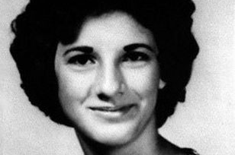
Karen Silkwood She died at the age of 28
Karen Silkwood tried to tell the truth to everybody and because of it, she had a terrible end, maybe caused by others who wanted to silence her.

Slide 12
My opinion about the book
I really enjoyed reading this book, it’s quite interesting because it’s a true story and allows us to take our own conclusions about Karen’s death, and even allows us to have our own opinion: if her death was either an accident or not.
I think for those who like serious, true, and mysterious stories it’s a very good book and all those people should read it. I also strongly recommend it because although it has a little complex vocabulary, it is easy to read.

