Slide 1
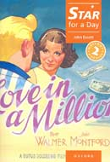
Star for a day
Escola EB 2,3 Dr. Ruy d’Andrade
Pedro Lopes nº17 9ºH
Teacher: Maria José Machado - English

Slide 2
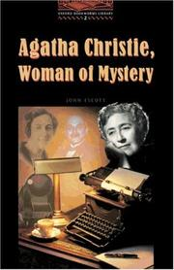
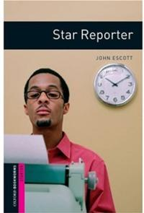
Author
John Escott started by writing children's books and comic scripts, but now writes and adapts books for students of all ages. He especially enjoys writing crime and mystery thrillers, and is a member of the British Crime Writers Association. With Oxford University Press John has published London for the Oxford Bookworms Factfile series; Agatha Christie, Woman of Mystery, Star Reporter, Girl on a Motorbike.

Slide 3
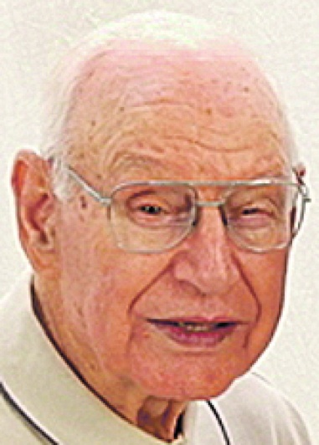
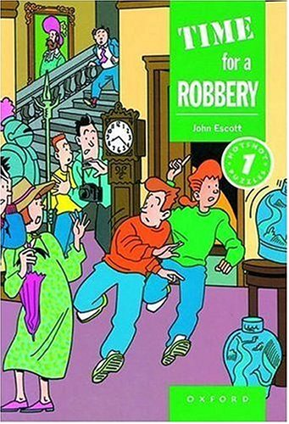
Author
The Fly and Other Horror Stories, and The Scarlet Letter for the Oxford Bookworms Library series; The Magician, Time for a Robbery, Star for a day, Tomorrow's Girl, and The Man with Three NAMEs for the Hotshot Puzzles series; and A Pretty Face for the Dominoes series.

Slide 4
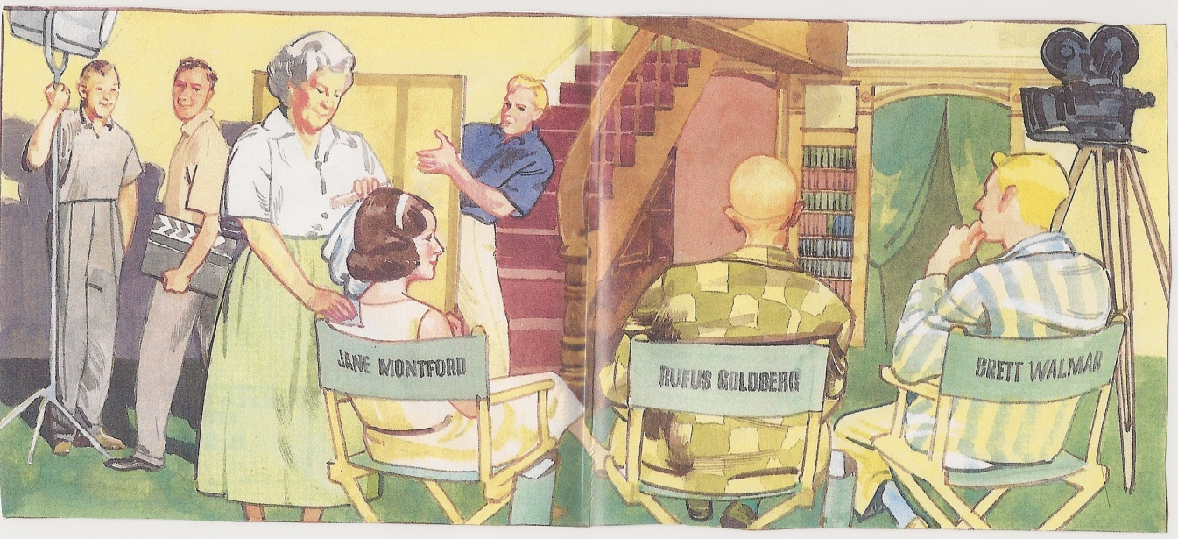
Book
Star for a day is a book where Joe Fleming worked at Topbox, making coffee and cleaning the floors. One day, Jane Montford started working at Topbox too. In the meantime Joe got a new job.

Slide 5
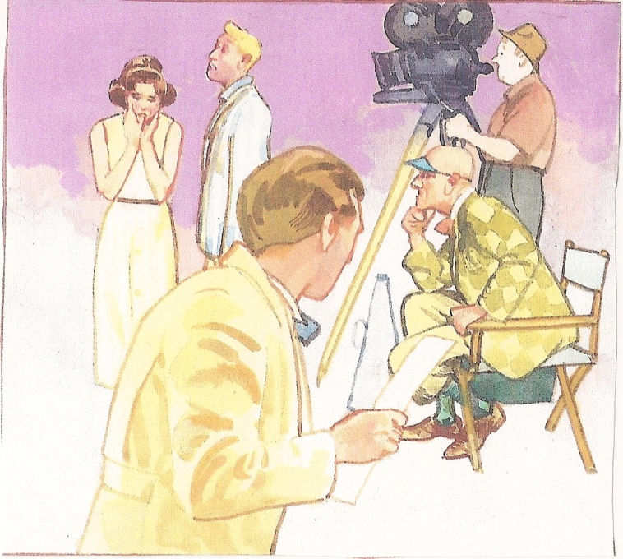
Book
This story was in 1937, and in this year, millions of Americans went to the movies every week. One of the major studios was Topbox Productions. Joe Fleming worked there. And he was in love with Jane Montford, one of the studio's biggest stars. Joe's friends made fun of him, because he was in love with Jane.

Slide 6
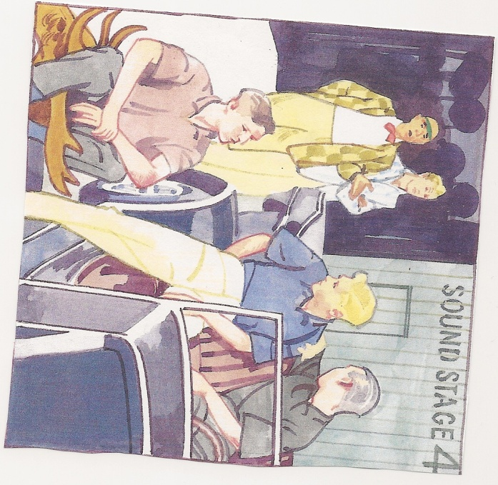
Book
For an unknown reason, Jane forgot her paper in the film, she forgot her words, which quite irritated Brett Walmar, the other main actor, and that intrigued the director, Rufus Goldberg.

Slide 7
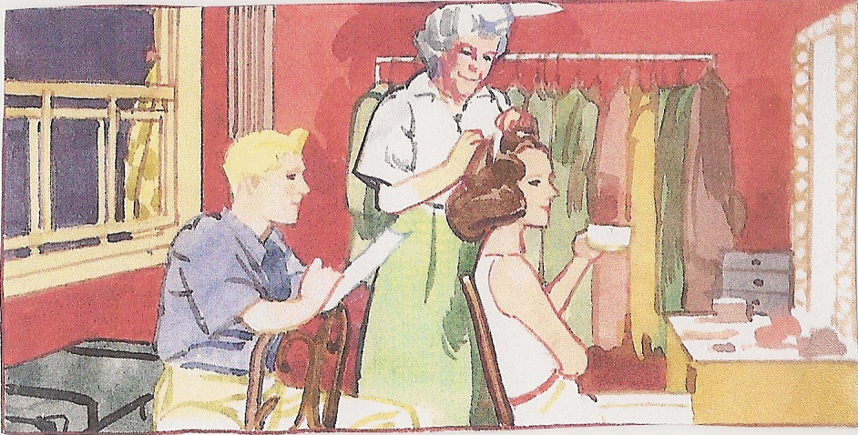
Book
One more try for that scene, but Jane forgot her words again, and she ran out of the studio to her dressing room. Rufus Goldberg stopped filming to tell Brett Wallmar that was impossible, because he made ​​things difficult for the actors who were working with him. Joe was very angry with Brett Wallmar.
Some time later, Rufus told Joe to take Jane some coffee . He did it, but she needed to practise her words, so she asked Joe if he could help her, and he accepted the request.

Slide 8
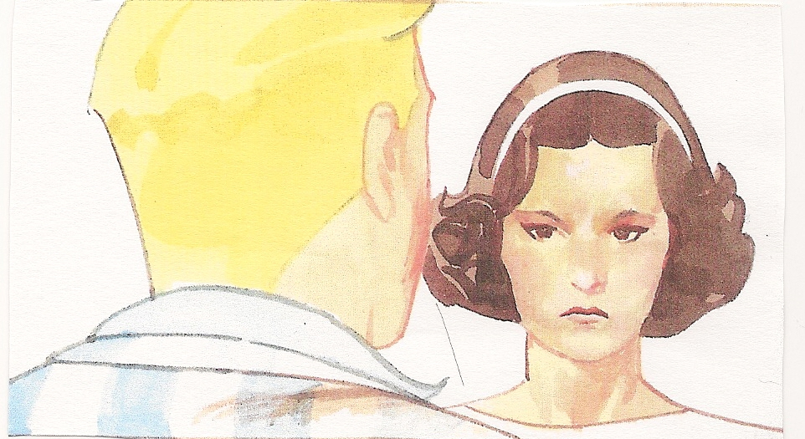
Book
Everybody was back again, ready to film. Jane said some of her words, and then stopped. She started crying. She told everybody that he made her forget all her words. Brett went to the dressing room, got some coffee, but Rufus asked him for his coat, because Rufus wanted to do something with the coat. Rufus called Joe, and asked him to put on this coat and say Brett's Words. Joe said Ok. Joe did the scene perfectly, but unfortunately, they were going to put Brett's voice on the film.

Slide 9
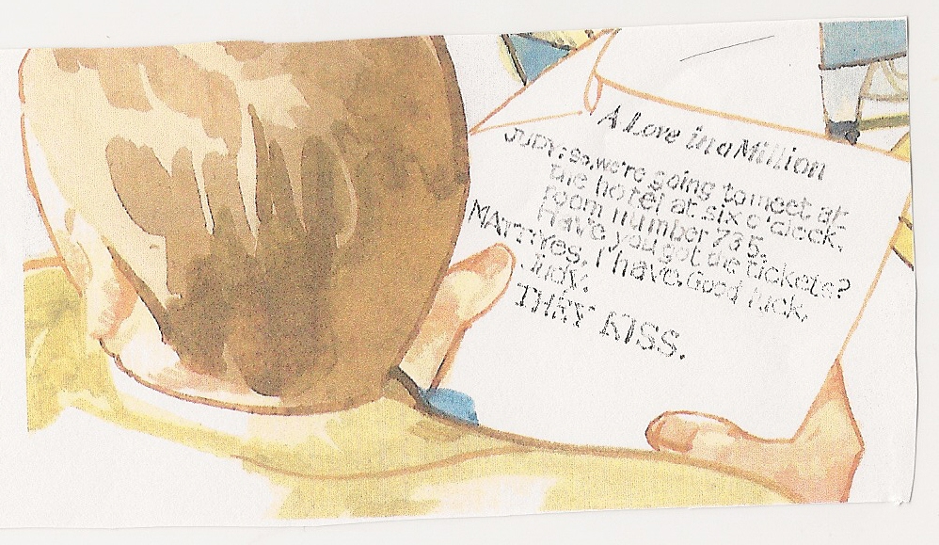
My opinion
I didn’t enjoy this book, because the story is very short, does not develop, and the images are bad. Besides it shows items and characters that do not enter in the story, so I believe they aren’t necessary.

