Slide 1
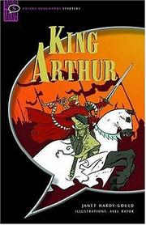
King Arthur
Escola EB 2,3 Dr. Ruy d’Andrade
Teacher:
Maria José Machado
Duarte Alves 9ºH Nº: 7

Slide 2
THE AUTHOR
Janet Hardy Gould is a writer. She was born in 1964 in Britain.
She is a published author of children's books. Janet Hardy-Gould wrote King Arthur, the Knights of the Round Table , Henry VIII and His Six Wives.

Slide 3
King Arthur story
It is the year 650 in England. There is war everywhere because the old king is dead and he has no son. Only when the new king comes can the fighting stop and the strange, magical story of King Arthur begin. But first, Merlin the ancient magician has to find a way of finding the next king...

Slide 4
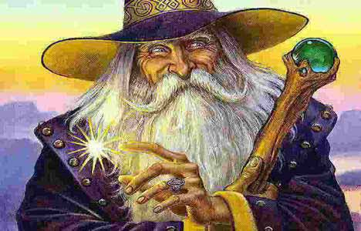
The BOOK
One night Merlin, the magician has a dream.
In the morning Merlin sees a wonderful king, named Arthur. In that day, Merlin makes a magic stone, he puts a sword in it and only the true king can pull out the sword.
After some tries, a boy suddenly appears – he’s Arthur. He pulls the sword and takes it out of the magical stone.

Slide 5
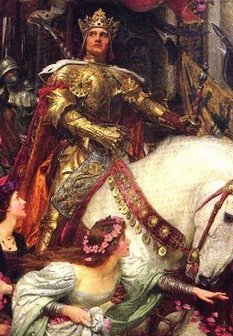
The book
Arthur discovers that he is a true king of England, but he doesn’t know how to be one.
Merlin suddenly appears, he tells Arthur that he will teach him how to be a good king.
Merlin teaches every day, and after four years, he is strong and a wonderful king.
One day, a soldier visits Arthur, he says that the lords of the North were going to fight him, so he decided to go to battle.

Slide 6
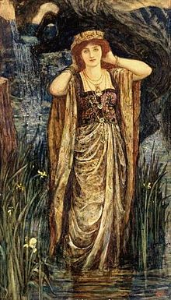
The book
Arthur after some hours wins the battle. Some minutes later, a lord tells Arthur to go to his castle to celebrate the victory drinking and eating all night.
The lord presents his daughter Guinevere to the king. Arthur and Guinevere talk all evening.
When Arthur came back, he told Merlin that he wanted to marry Guinevere, but Merlin said no, because he saw a dark future.

Slide 7
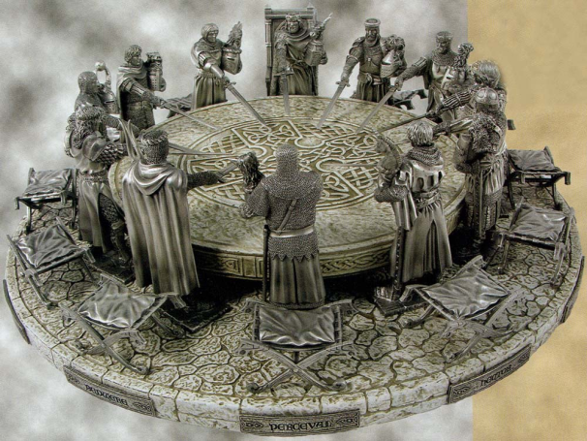
The book
Arthur builds a castle for Guinevere, his future Queen.
It was when Merlin started losing his magic, so he gives Arthur a magical sword so he could protect himself, because Merlin had to leave.
Three weeks later, the king marries Guinevere. The people are happy, but there are others that are happier than them, Morgan and her son Mordred.
Guinevere gives Arthur a large round table, where the strongest knights of England will sit.

Slide 8
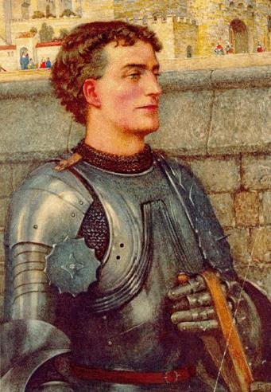
The book
The strongest knight in England was Lancelot, he was the first man of the Round Table.
Lancelot becomes Arthur and Guinever’s best friend. The knight starts to love the Queen.
One night Morgan and Mordred arrive at Camelot. The king tells them to stay.
In the morning Arthur visits Morgan and he tells her that if he died, Mordred could be king.
Arthur when sleeping hears Merlin saying : be careful!

Slide 9
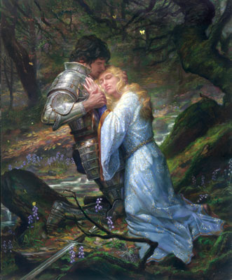
The book
Morgan sees in the future, no king, no castle and Mordred becoming a king.
Lancelot, after the battles, danced with the Queen every evening, while the knights were eating and drinking.
One day, Mordred comes to Arthur, and says that perhaps Lancelot and Guinevere are in love.
Still in the day, Arthur talks with Lancelot and tells him to leave Camelot. Without Lancelot the magic of the Round Table is dead.

Slide 10
The book
In the towns and villages everyone started to fight again, because they were afraid.
One day Mordred comes to Arthur and tells him to find Lancelot and fight him. In the following day Arthur and his knights leave Camelot.
When they were ready to fight, a soldier arrived from Camelot saying that Mordred was the new king. Lancelot and Arthur forgot the battle and went to fight against Mordred.
After three hours, Arthur won the battle but lost many knights and soldiers.

Slide 11
The book
A couple of minutes later, Lancelot and his soldiers arrived, and found Arthur laying down on the ground, hurt by Mordred that ended up killed by Lancelot some minutes later.
Lancelot threw Arthur's sword into the water, but suddenly a hand grabbed the sword. It was Merlin who grabbed the sword.
Arthur went with Merlin to a far place, where he could sleep and rest.

Slide 12
My opinion
I enjoyed this book very much because the story is very good and full of adventure, I liked the characters too, but what I liked most were the images.
With this book I can now understand more about the history of England.

