Slide 1
Escola 2/3 Dr. Ruy d’ Andrade
The Fourteenth Character
Fifteenth
Why is the clown
on the cover?
João Pereira 9ºH Nº15
*novosusadosereciclados.blogspot.com

Slide 2
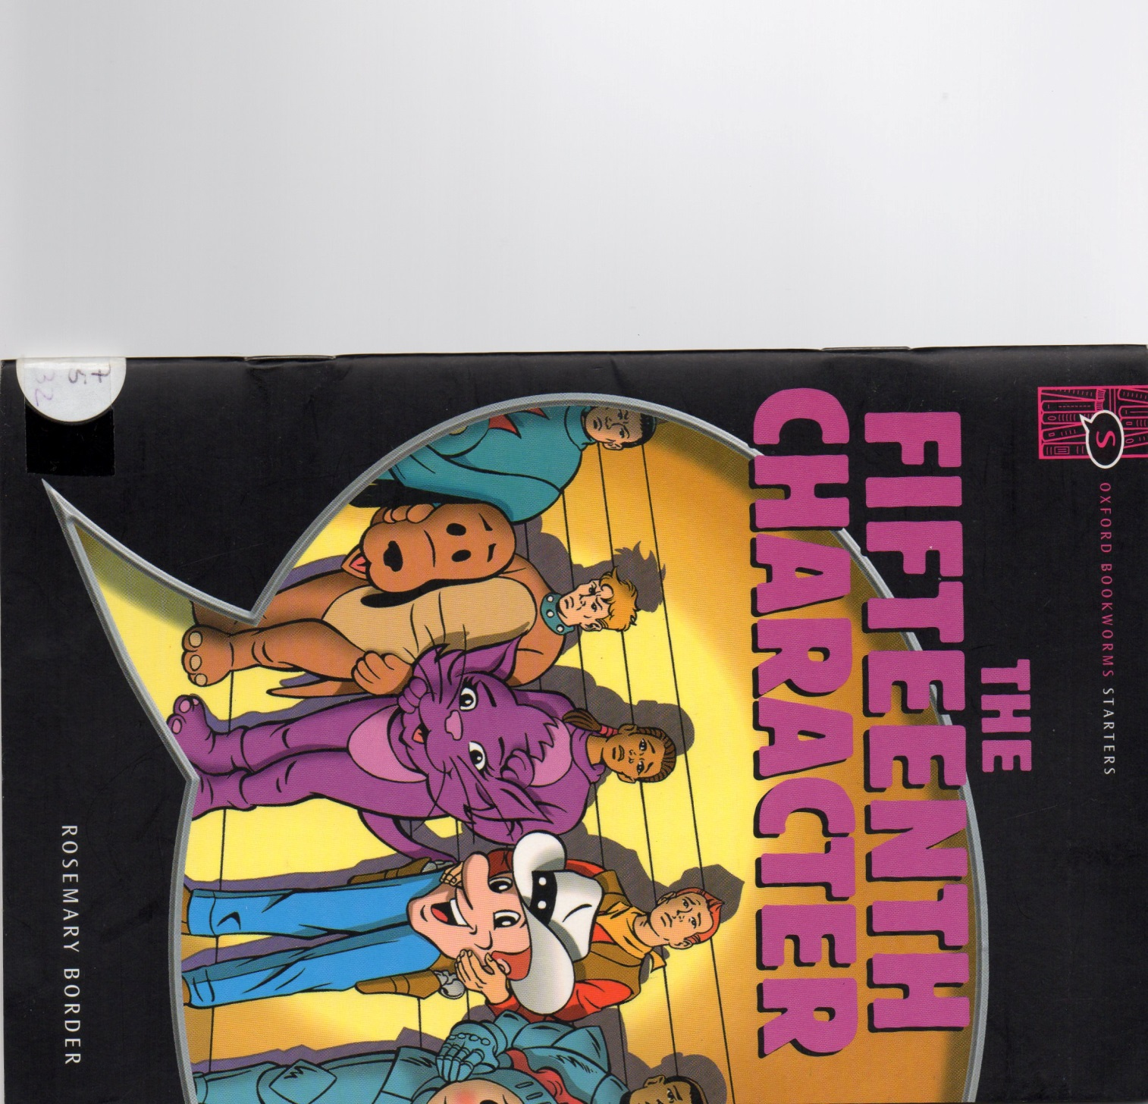
The author…
Rosemary Border was born in 1930.She is a published adapter, author, and an editor of children's books. Rosemary wrote books like “Ghost Stories”, ”The Piano”,”Love Story”, ”The Fifteenth Character”…

Slide 3
The book…
Sally Brown needed to earn money to be a teacher, so she got a part-time job in the theme park “Happy Hills”.

Slide 4
The book…
That day was very special for two reasons: It was the opening of the new “Zapp-o-Copter” and Zapp , a singer, was supposed to arrive.He was Sally’s favourite singer.

Slide 5
The book…
Every morning, Mr.Parry, the director of the park used to put a list of “Jobs for Today” in the workers canteen.In that list it appeared the jobs for each worker.Sally was the “Connie Cat”, a costume.

Slide 6
The book…
Zapp cut the rope, and then he took out of his pocket a CD. It was the new song!

Slide 7
The book…
The day was very special when the CD disappeared…

Slide 8
The book…
The police arrived and they looked everywhere for the CD. First they searched the visitors and then the workers.

Slide 9
The book…
Sally waited quietly with the other workers. Unconsciously, she looked at Mr.Parry’s list and counted the names…Fourteen!But there were fifteen in the room!

Slide 10
The book…
“Charlie Clown” wasn’t on the list, but “he” was there!Charlie Clown began to run, but William, a police man, stopped “him”!”He” was the robber…

Slide 11
Opinion of the book…
I chose this book because the cover seemed interesting, but when I started reading it the content did not correspond to the cover, so I didn’t like this book.

