Slide 1
AROUND THE WORLD IN EIGHTY DAYS
Teacher: Mª José Machado
João Canelas nº14 9ºH

Slide 2
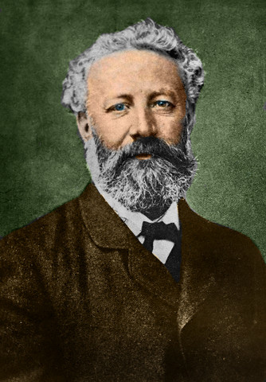
The writer: Jules Verne
Jules Gabriel Verne was born on 8th February 1828 and died on 24th March 1905. He was the French writer who pioneered the science fiction genre. He is best known for his novels Twenty Thousand Leagues Under the Sea, Journey to the Centre of the Earth, From the Earth to the Moon and Around the World in Eighty Days.

Slide 3
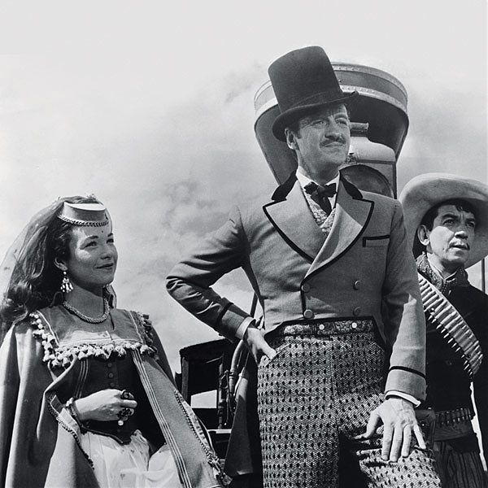
The story
Phileas Fogg,
a gentleman
Passepartout, a servant
London , 1872

Slide 4
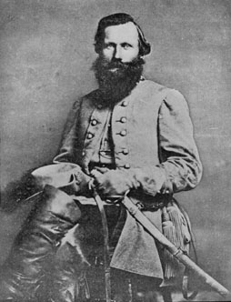
A notice worried the gentlemen at Fogg’s club
The thief took £5.000
“ It’s possible to go around the world in 80 days”- said Fogg
Stuart would give him £20 .000 if Fogg went around the world in 80 days

Slide 5
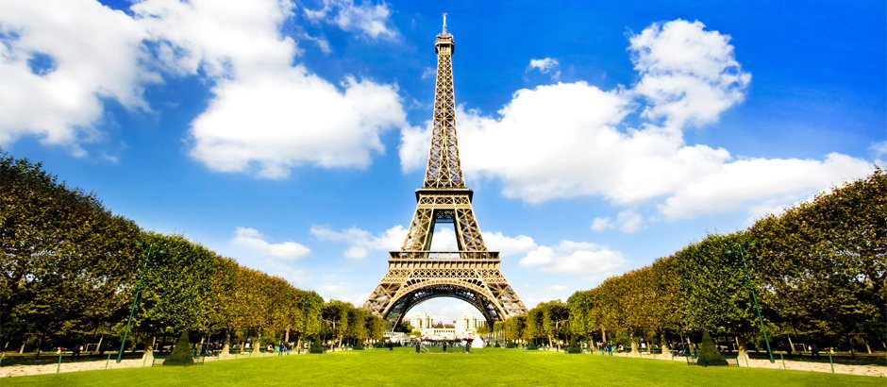
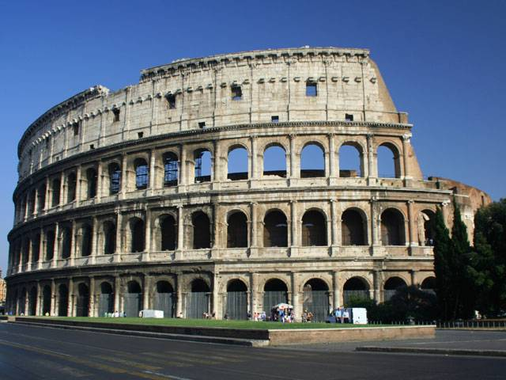
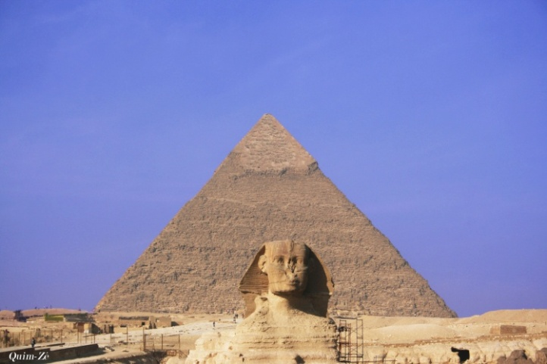
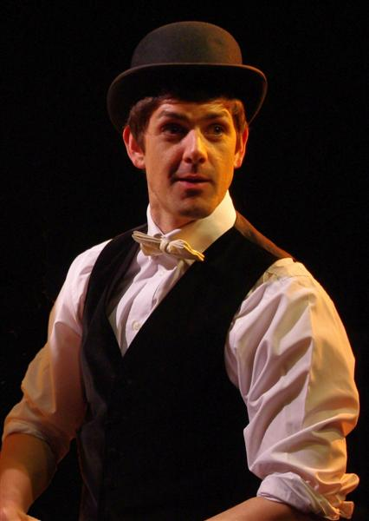
Fogg must be back until 21 st December
Fogg and Passepartout went to France, Italy and Egypt
Mrs Fix,
a detective who was looking for the thief

Slide 6
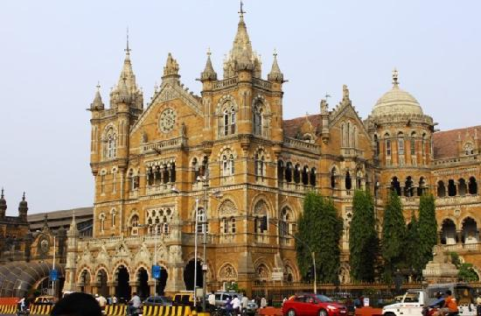
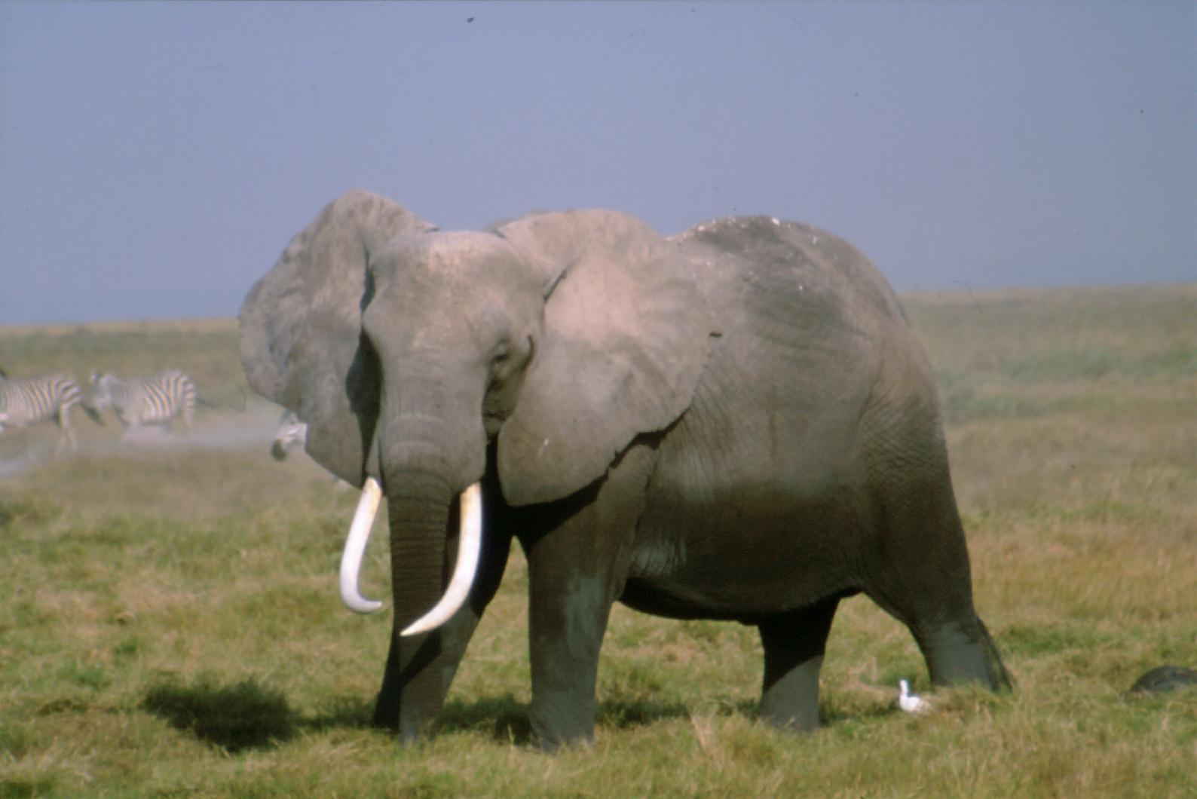
Bombay
Passepartout didn´t take off his shoes and the priest got angry
They wanted to go by train but the railway station wasn´t finished
So, they used an elephant

Slide 7
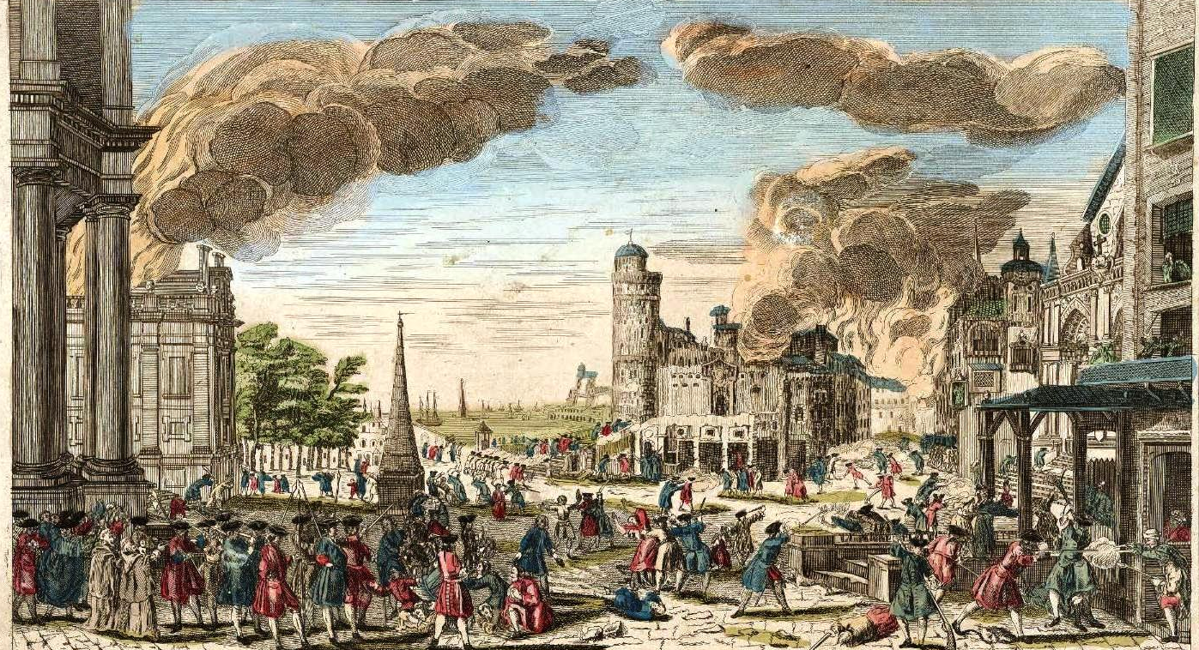
In Pillage, the old prince was dead and his young wife should have died with him in a big fire
Passepartout put the prince`s clothes and saved the princess, and they all left quickly on the elephant

Slide 8
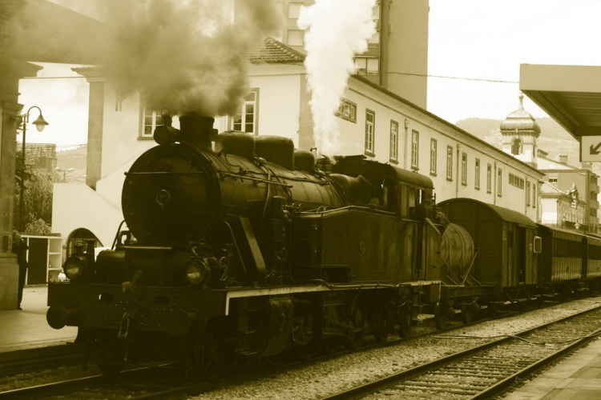
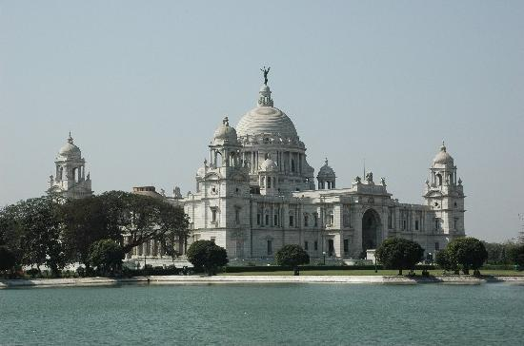
Miss Aouda, the princess
Allahabad
Calcutta
They went by train to Calcutta

Slide 9
At Calcutta a policeman took them to a judge
The judge wanted to put them in prison because they broke rules in several temples
Fix was in the court
Fogg paid him not to be put in prison

Slide 10
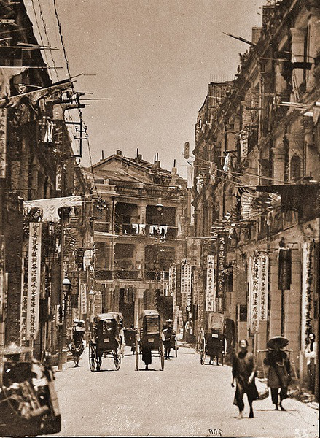
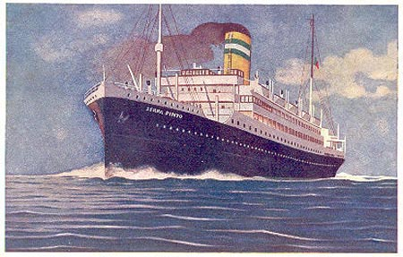
Passepartout found that Fix worked to Mr. Stuart, and he wanted to arrest Fogg .
So Fix put Passepartout drank and in a ship to Japan
Hong Kong
Fogg and Miss Aouda left in another ship and Fix followed them

Slide 11
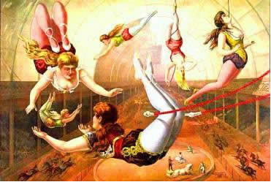
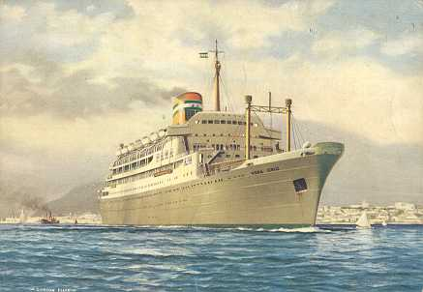
Passepartout started to work in a circus to earn more money
One week later Fogg, Miss Aouda and Fix arrived in Japan and started to look for Passepartout
When they found him they left in a ship to America

Slide 12
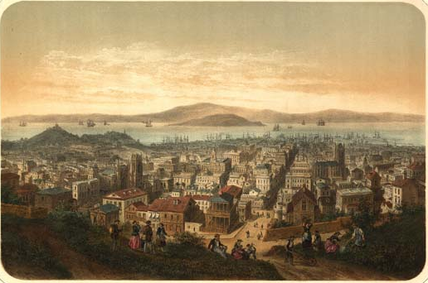
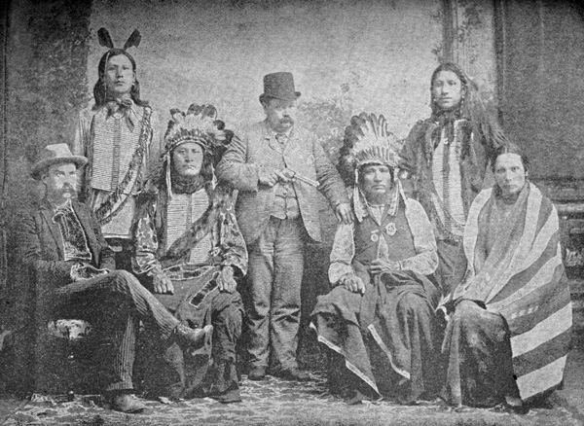
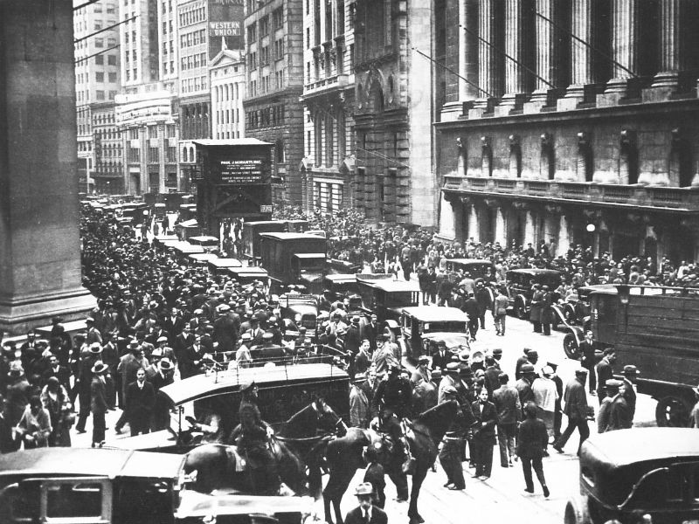
3rd of December, San Francisco
Train to New York
The train was stopped by Sioux Indians who took
Passepartout and others passengers away

Slide 13
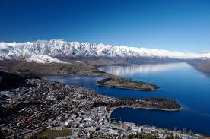
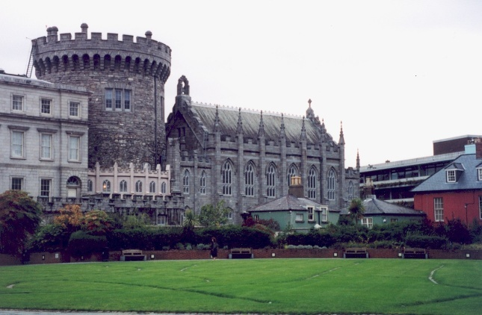
They went to look for Passepartout and after that they went to New York
They arrived in Queenstown and they had to take the train to Dublin and a ship to Liverpool
When they arrived Fix arrested Fogg but it was a mistake , he wasn`t the thief
Fogg and Miss Aouda got married
They went in a train to London,
Fogg won the bet to Stuart

Slide 14
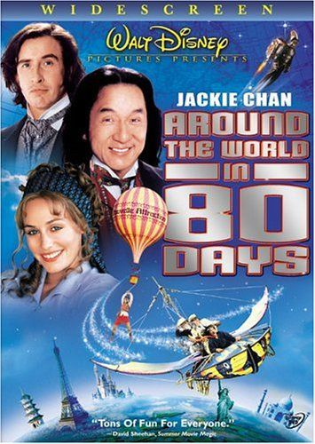
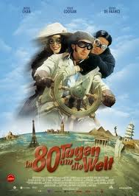
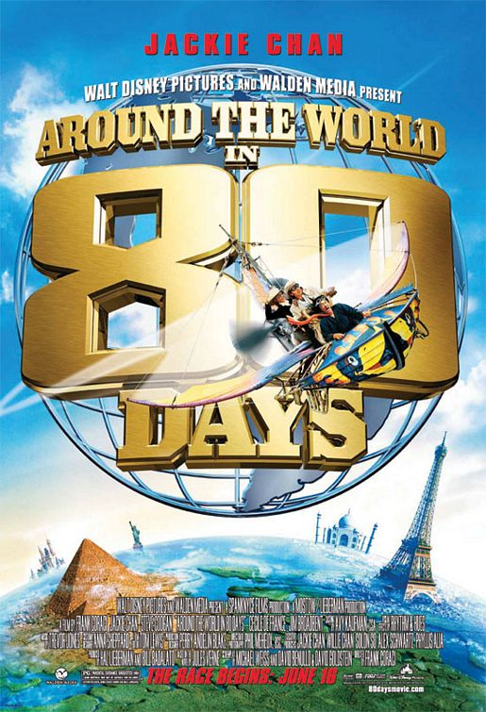
My opinion
From a train to an elephant “ Around the World in Eighty Days” is one of the most exciting adventures that I have ever read by Jules Verne.
So I really enjoyed this story and I recommend it to the people read the book . You can also watch some of his flms.

